Slide 1
Basic Botany and
Intensity Estimation
Part 5: Leaf size and pollen & helpful resources
National Coordinating Office
USA-NPN
Notes:
For part 5, we will look more closely at the oddball categories of leaf size and pollen.

Slide 2
INTENSITY
What % of full size are most leaves?
5-24%
25-49%
50-74%
75-94%
Less than 5% 95% or more
Notes:
For the phenophase intensity question about leaf size, we will use the same percentage bins as for open flowers, ripe fruits, and leaf canopy.

Slide 3
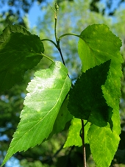
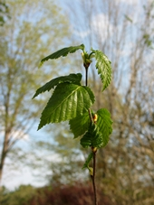
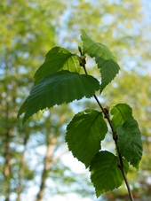
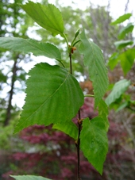
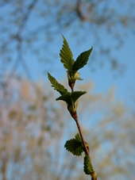
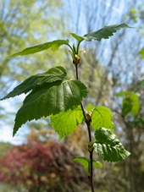
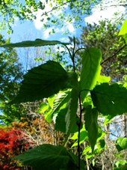
INTENSITY
What % of full size are most leaves?
Mature leaf
25-49%
50-74%
75-94%
Photos: Ellen G Denny
paper birch, Betula papyrifera
Notes:
As with percent canopy, to answer this question you will first need to know what the leaf looks like at full size. Taking a measurement or a photo including an item for scale when your leaves are at full size might help you better estimate percent of leaf size in the future. The photos, from left to right, show this tree at 25-49% leaf size, 50-74%, and 75-94%.
Now you try! You will be given a photo of a leaf at full size, then asked to estimate the percent of full size of the same tree earlier in the year.

Slide 4
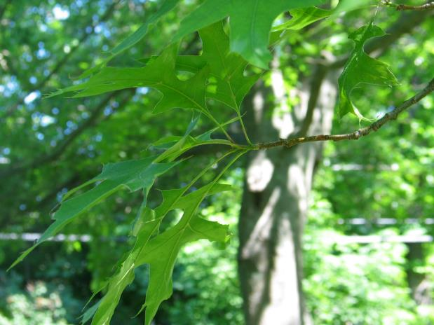
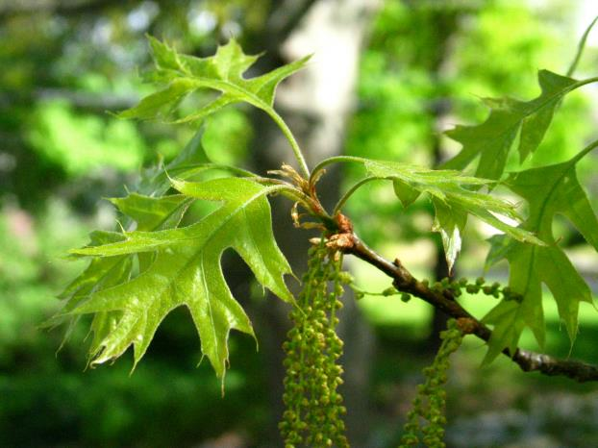
INTENSITY
Pop Quiz!
What percent of full are most leaves?
Less than 5%
5-24%
25-49%
50-74%
75-94%
95% or more
Knowing that this leaf is full size:
black oak, Quercus veluntina
Photos: Ellen G Denny

Slide 5
INTENSITY
Pop Quiz!
What percent of full are most leaves?
Less than 5%
5-24%
25-49%
50-74%
75-94%
95% or more
Knowing that this leaf is full size:
black oak, Quercus veluntina
Photos: Ellen G Denny
Notes:
43%

Slide 6
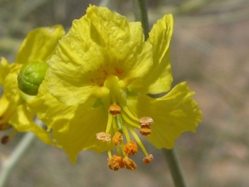
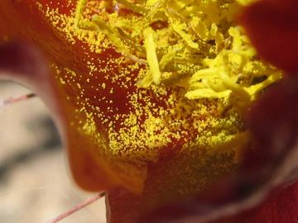
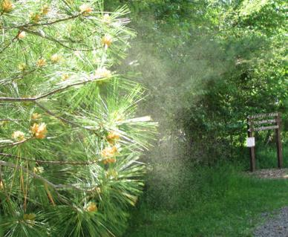
INTENSITY
How much pollen is released?
Little: Only a few grains are released.
Some: Many grains are released.
Lots: A layer of pollen covers your palm, or a cloud of pollen can be seen in the air when the wind blows
Photos: Patricia Guertin,
Beatriz Moisset via Wikimedia Commons
Notes:
The last phenophase we will describe is pollen release. The intensity question asks How much pollen is released. You are given three qualitative answers to choose from: little, some, or lots. Read the definitions of each for a better understanding of each category.
Now you try!

Slide 7
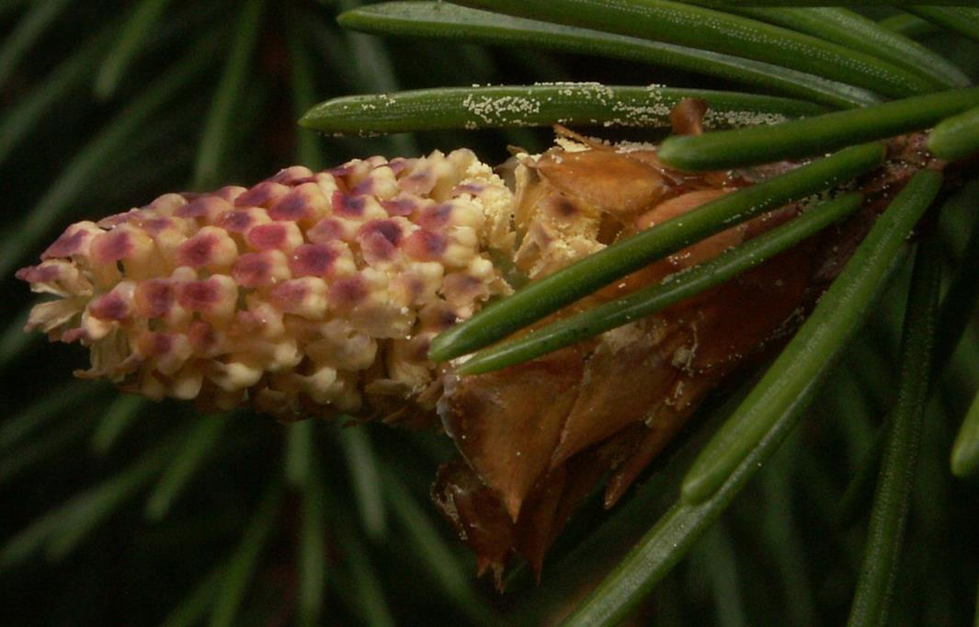
INTENSITY
Pop Quiz!
How much pollen is released?
Little
Some
Lots
Photo: B.gliwa via Wikimedia Commons

Slide 8
INTENSITY
Pop Quiz!
How much pollen is released?
Little
Some
Lots
Photo: B.gliwa via Wikimedia Commons

Slide 9
Notes:
We hope that these quizzes will help you to become more confident in understanding botany and estimating intensity of plant phenophases. Thank you so much for participating in Nature’s Notebook.

